Slide 1
QLS-612 2024 Module 5
Inés Gonzalez Pepe
Numpy & Scipy

Slide 2
Numpy

Slide 3
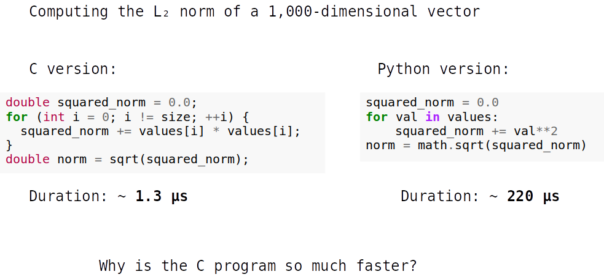

Slide 4
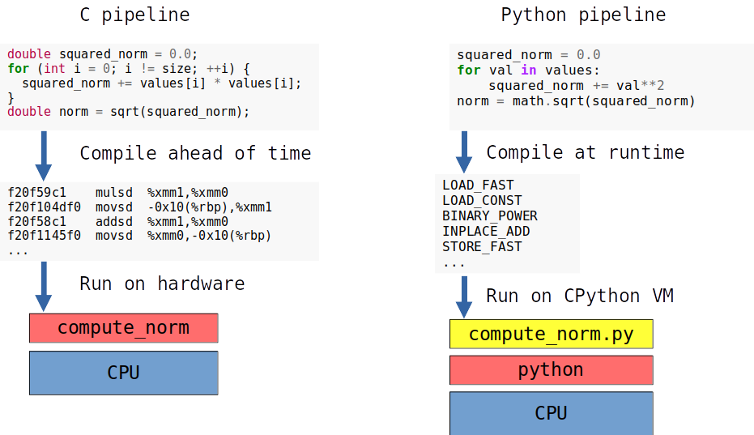

Slide 5
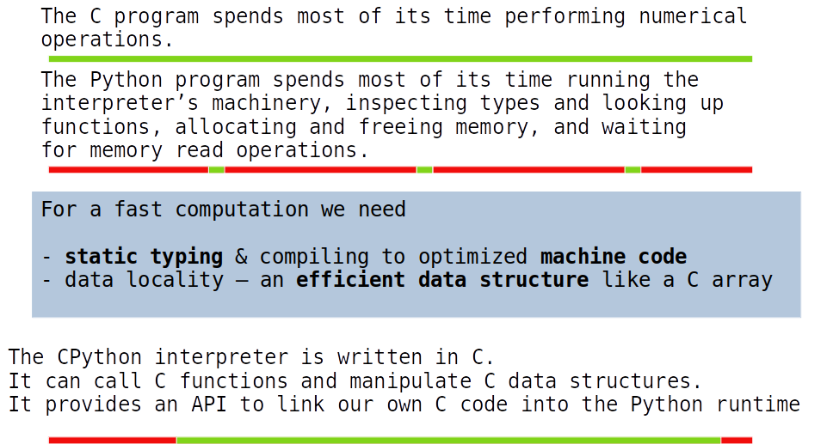

Slide 6
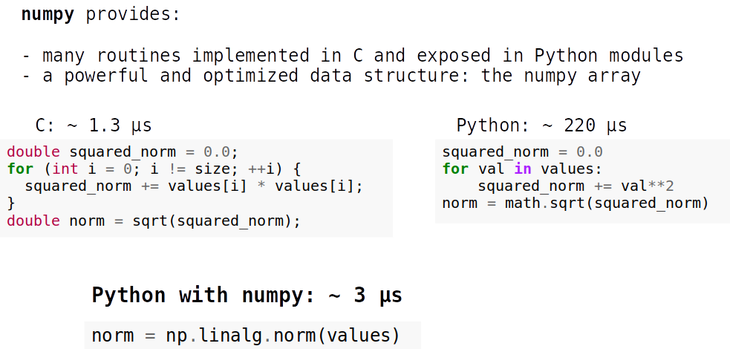
Notes:
Numpy is fast because most operations are still done in C and the values in it are always of a fixed type; ex in the same array you will always be working with only floats or ints or whatever the type of that array is determined to be
Numpy also uses contiguous memory (list items could be scattered around in the computer’s memory)

Slide 7
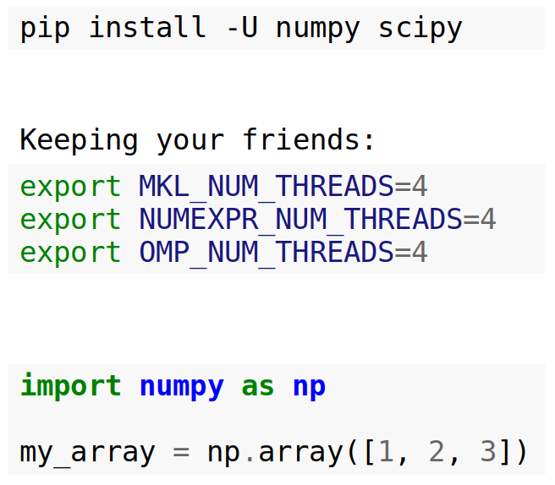
Getting started with NumPy

Slide 8
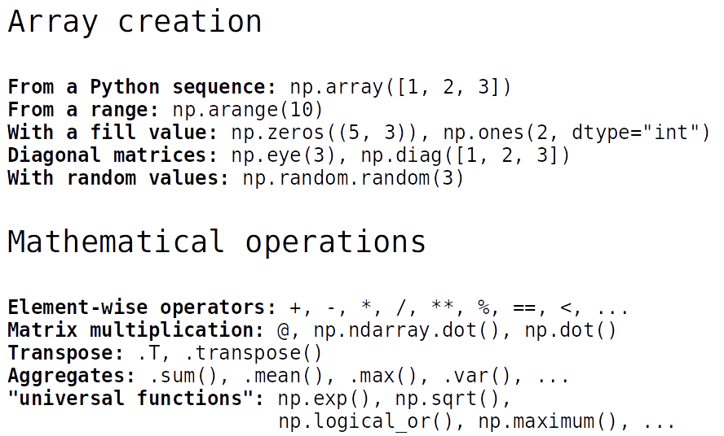

Slide 9
Let’s checkout the Jupyter Notebook

